Slide 1

Optimal Product Price Analyzing System
SRM INSTITUTE OF SCIENCE AND TECHNOLOGY
SCHOOL OF COMPUTING
DEPARTMENT OF NETWORKING AND COMMUNICATIONS
18CSP109L - PROJECT
Final Viva
13 -05-2022
RA1811030010069 – AKSHAT GOEL
RA1811030010085 – SACHIN VERMA
Dr. S. Prabakeran, Assistant Professor
Department of Networking and Communications

Slide 2
Table of contents
Introduction – Problem statement
Objectives
Literature Survey
Architecture diagram
Diagrams
Algorithms used
Modules Description
Implementation
Results and Discussion
Screenshots
References

Slide 3
Introduction
The Optimal Product Price Analyzing System is used to fetch the lowest price available of a product from the internet.
It involves the usage of modern technologies like web scrapping, Data Science and Data Analytics.
By applying the Optimal Product Price Analyzing System you’ll not only be able to tell the lowest price of a product but also be able to analyze the product data available on the internet.

Slide 4
Objectives
The main aim of Optimal Product Price Analyzing System is to find the best price of the product from Ecommerce websites like Amazon, Flipkart etc.
It comprehensively includes a variety of important techniques, such as analyzing, modeling, visualization and evaluating.
It has broad application prospects in areas such as price monitoring, news monitoring, trend recognition and lead generation.

Slide 5
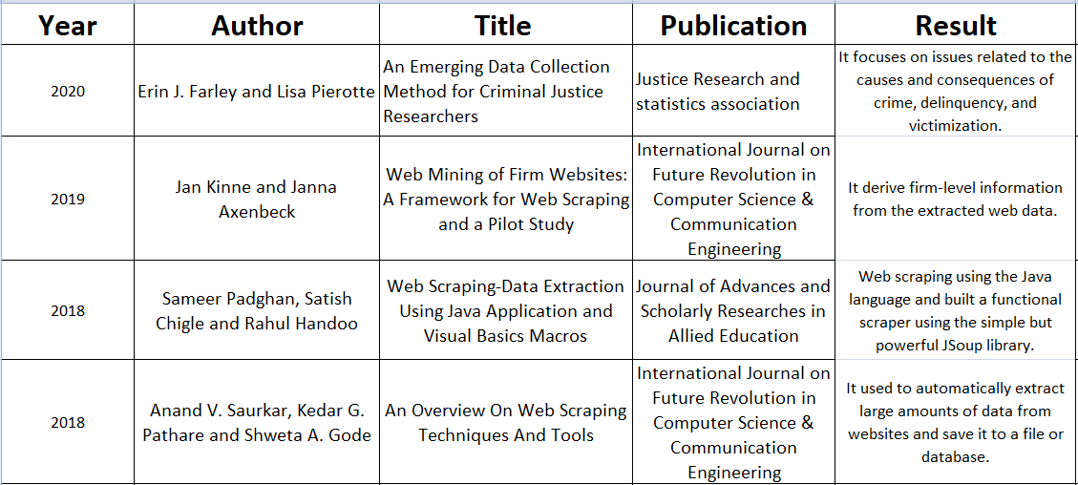
Literature Survey
Inference

Slide 6
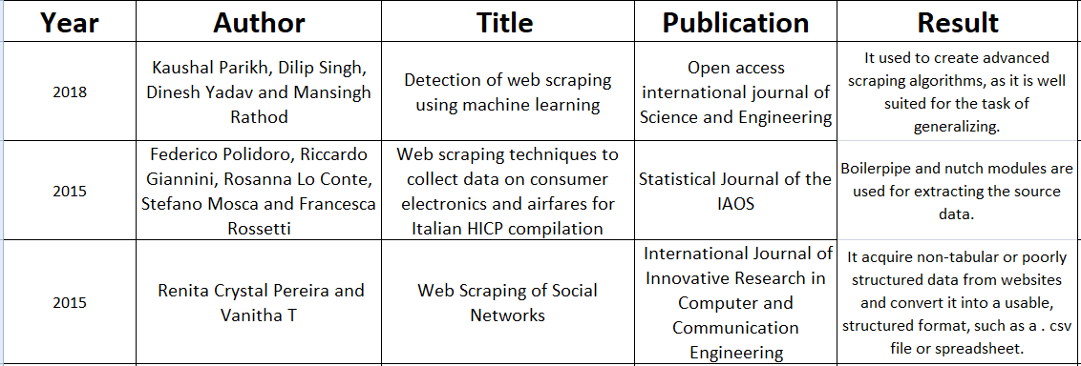
Literature Survey

Slide 7
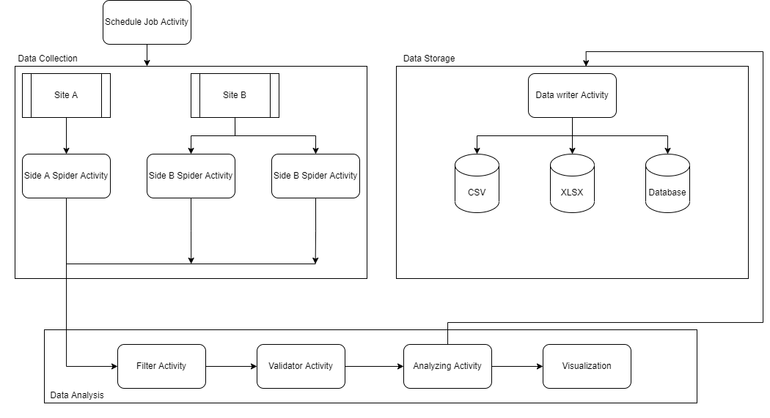
Architecture diagram

Slide 8
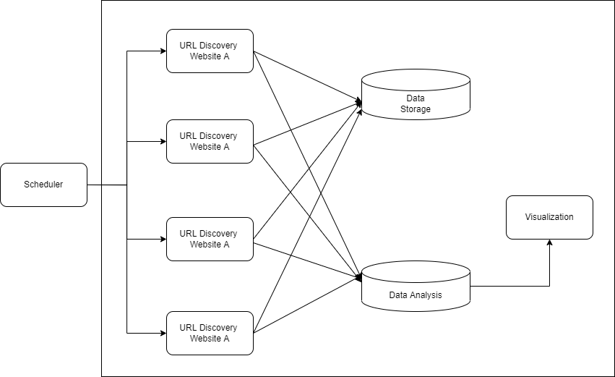
Diagram
Use Case Diagram

Slide 9
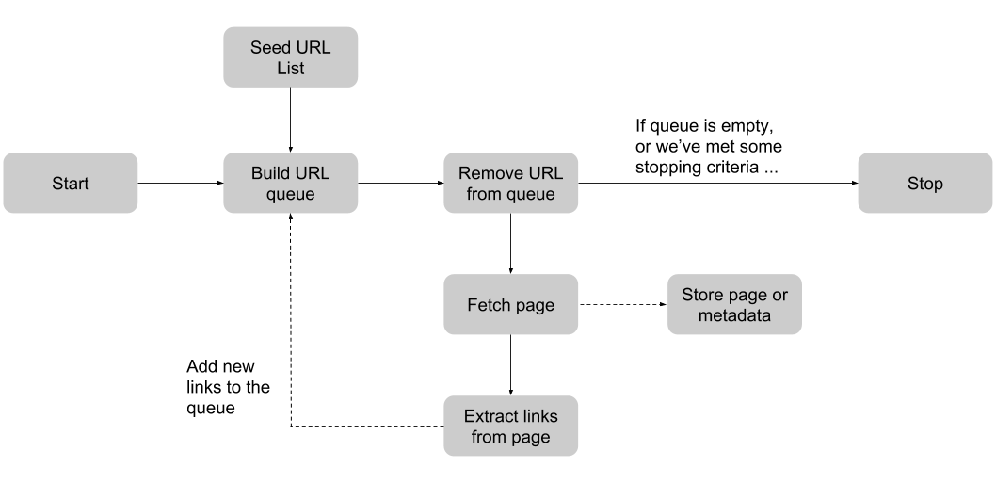
Diagram
Data Flow Diagram

Slide 10
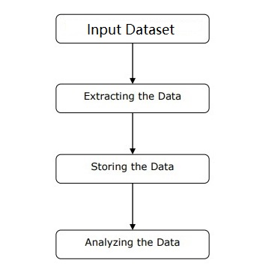
Algorithm
Product Price Analyzing System is a web automation system which is used to extract as well as analyze the optimal product price.
It is divided into 5 steps:-
- Basic Data
- Fetching Raw Data
- Appling Filter
- AVE of Data
- Data Concluder

Slide 11
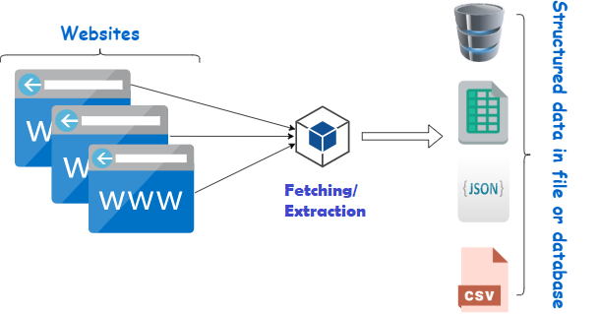
Algorithm
First, user need to collect the basic information such as product type, product name, websites on which product is available. This is one time process.
The next step is to collect raw data of the product, which is the structured web data from E-commerce websites such as Amazon, Flipkart etc.

Slide 12
Algorithm
The following steps are:-
Identify the target website.
Collect URLs of the pages where you want to extract data from.
Make a request to these URLs to get the HTML of the page.
Use locators to find the data in the HTML.
Save the data in a JSON or CSV file or some other structured format.
There are times when collected data may contains useless information, then we need to apply some filters to exclude those information.

Slide 13
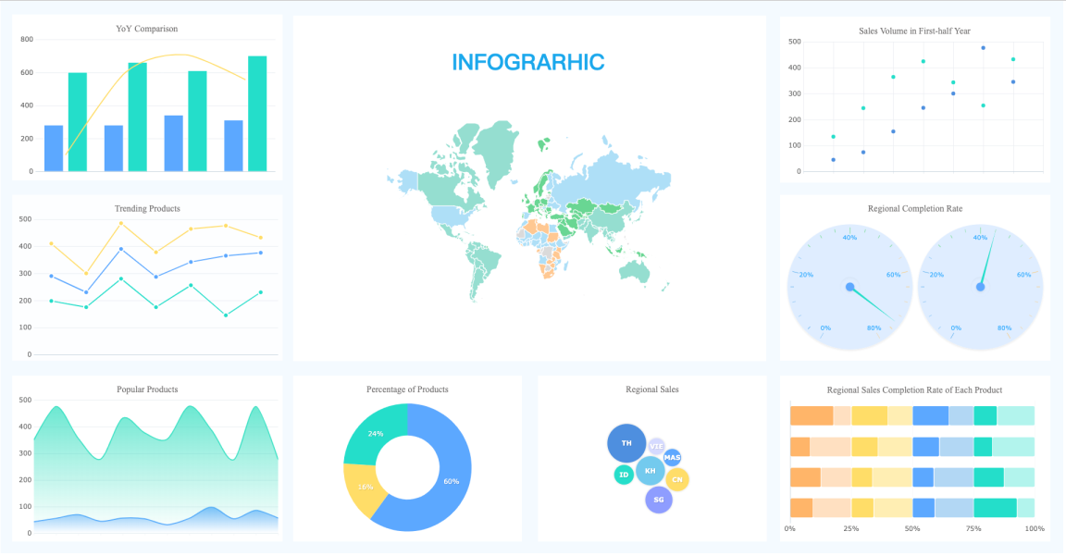
Algorithm
AVE of data includes Analyzing, Visualization and Evaluating of data which helps the end user to get optimal information in more refined manner. And also it help the strategist or data concluder to take further steps in optimizing the product.

Slide 14
Modules Description
The main modules that we use in Product Price Analyzing System :-
Info. Dataset– It the dataset of product items which are used to extract the raw information from the internet
URL Crawler– It is used to crawl the web pages of a domain to extract the URLs which are indexed on search engine.
XPath Locator– XPath Locator is to find the element in the webpage .
Exception Handler – This module is used to check whether the URL & Xpath is working or not.
Firefox Webdriver– It is used to provide a link between test cases and the firefox browser. We use GeckoDrive in this case.

Slide 15
Modules Description
Analyzing Module – It help the user with complex mathematical operations on arrays and matrices.
VE Module – It provide graphical plotting functionality to the interpreted data.
Concluder – It helps the end user in concluding with output data and also help in formulating strategic decisions.
Scheduler– It helps in executing a particular block of code at a given time on its own (i.e, without the involvement of user again-and-again).

Slide 16
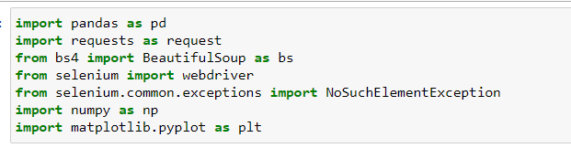
Implementation
Import Modules :-
Establishing connection with firefox :-
driver = webdriver.Firefox()

Slide 17
Implementation
Import Dataset :-
Identify the target website
Collect URLs of the pages where you want to extract data from
Make a request to these URLs to get the HTML of the page
Use locators to find the data in the HTML
Save the data in a JSON or CSV file or some other structured format
Input_data.xlsx is the dataset which we are using to extract data from the internet. Output_df is the dataframe which will store the filtered data.
input_df = pd.read_excel('input_data.xlsx')

Slide 18
Implementation
Output_df is the data frame which contains the extracted data from webpages.
output_df = pd.DataFrame(columns = ['Product', 'Amazon_price', 'Amazon_rating', 'Amazon_rating_count', 'Flipkart_price', 'Flipkart_rating', 'Flipkart_rating_count'])
LOG_df is a kind of log file which contains the error while extracting the data from webpages.
LOG_df = pd.DataFrame(columns = ['Product', 'Amazon_link', 'Amazon_price_xpath', 'Amazon_rating_xpath', 'Amazon_rating_count_xpath', 'Flipkart_link', 'Flipkart_price_xpath', 'Flipkart_rating_xpath', 'Flipkart_rating_count_xpath'])

Slide 19
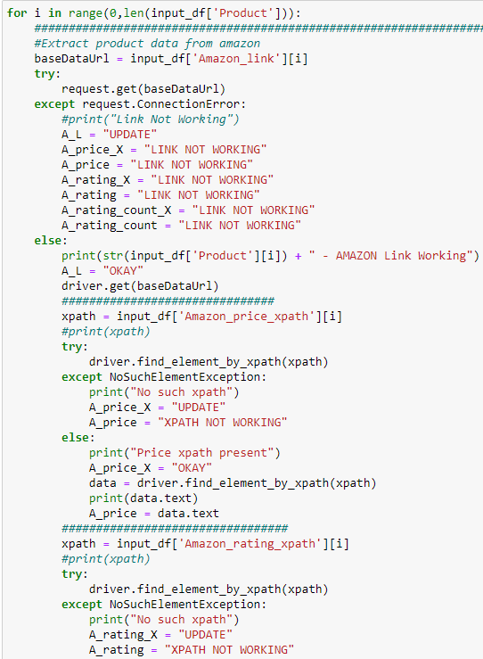
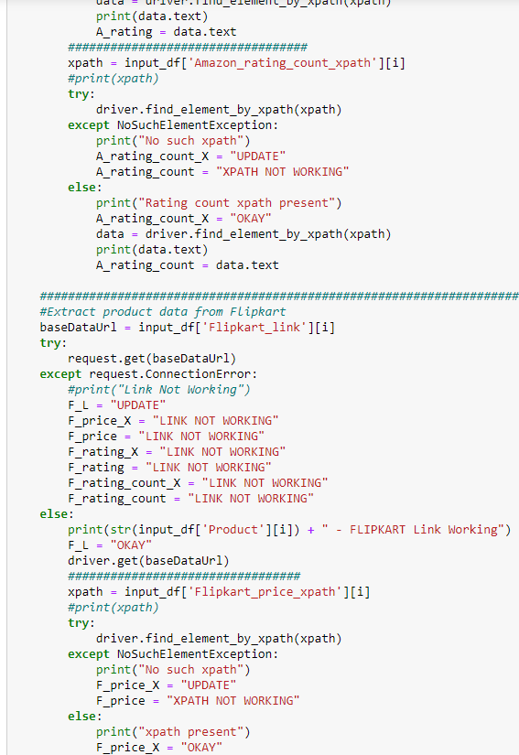
Implementation
Extraction of Raw Data

Slide 20
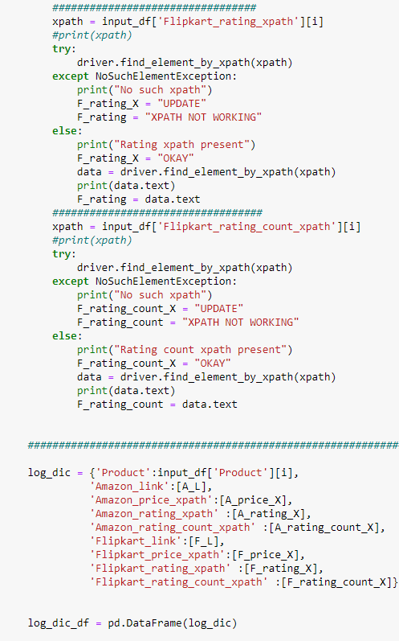
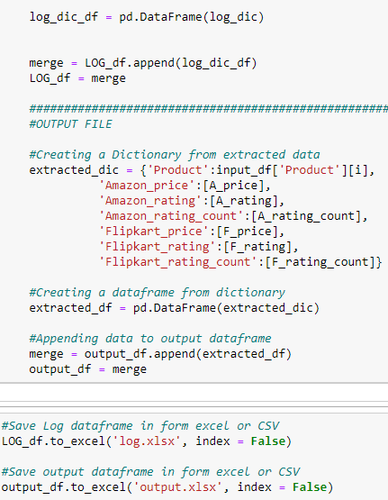
Implementation

Slide 21
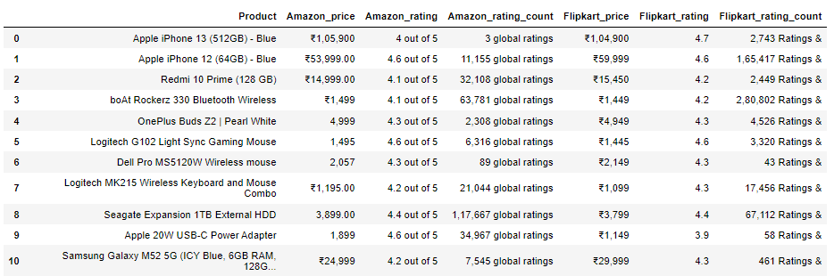
Results & Discussion
Extracted data:-
This is the Raw data which is extracted with the help of product
link & xpath locator. We need to filter this data to make it useful
for the user.

Slide 22
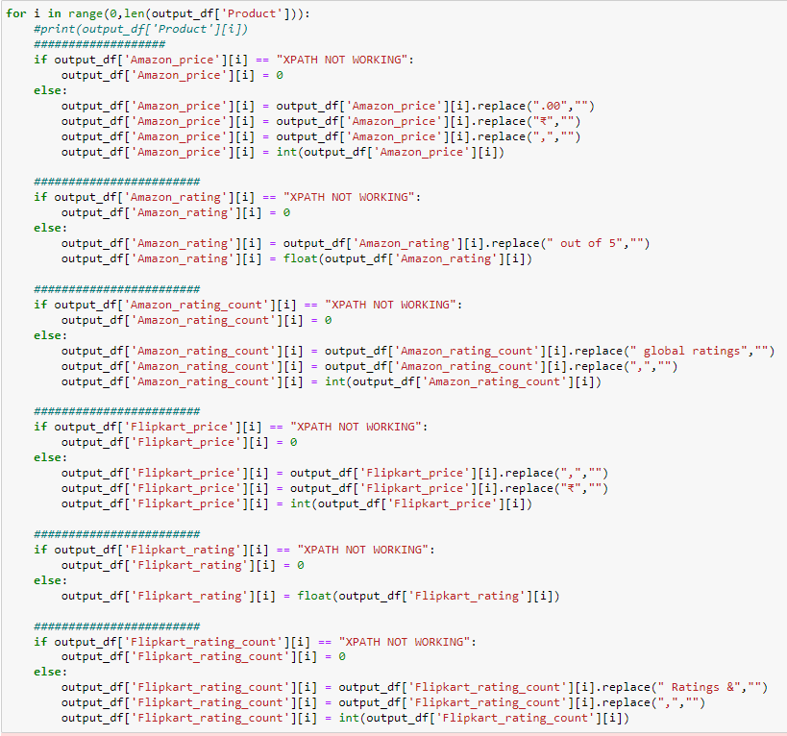
Implementation
Filtering/ Appending the raw data:-

Slide 23
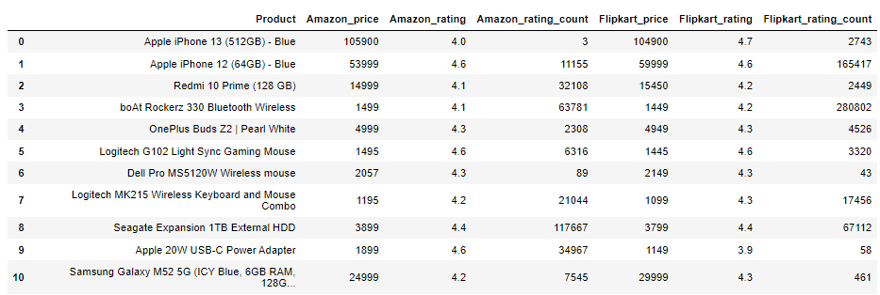
Results & Discussion
Filtered data:-
This is filtered data, free from garbage value and unnecessary
Information. This data will serve as base dataset for analyzing
system.

Slide 24
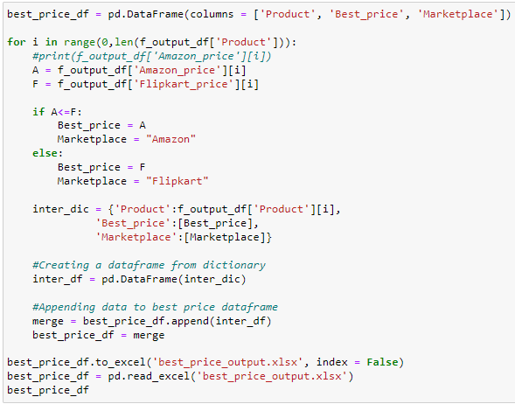
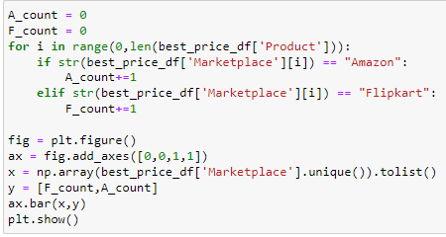
Implementation
Best Price Analyzing:-

Slide 25
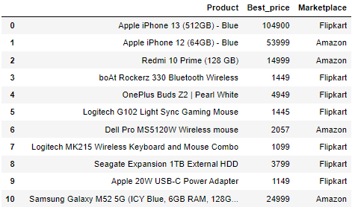
Results & Discussion
Best Price Analysis:-
Best Price analysis helps in providing the best price available for
a product and it also suggest the corresponding marketplace.

Slide 26
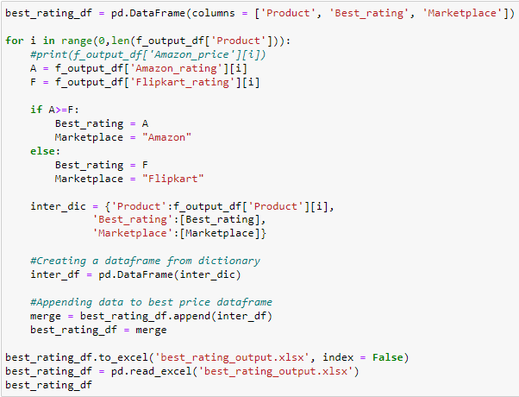
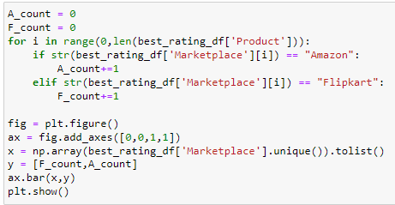
Implementation
Best Rating Analyzing:-

Slide 27
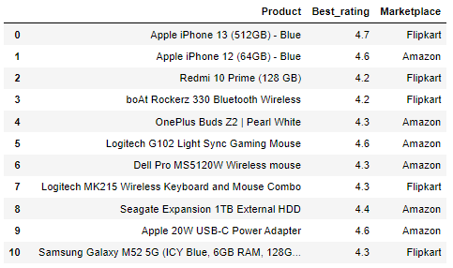
Results & Discussion
Best Rating Analysis:-
Best Rating analysis helps in providing the rating available for
a product and it also suggest the corresponding marketplace.

Slide 28
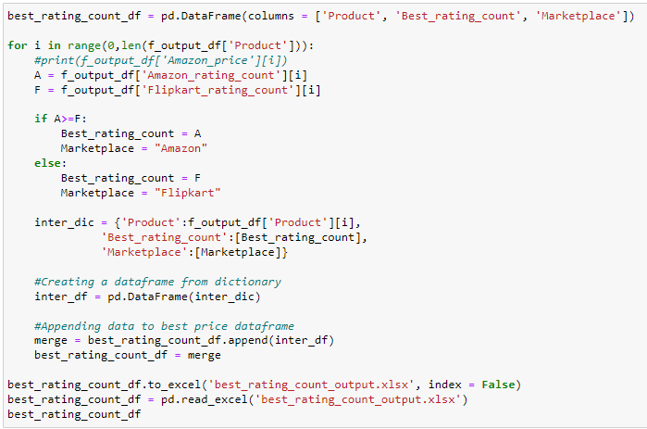
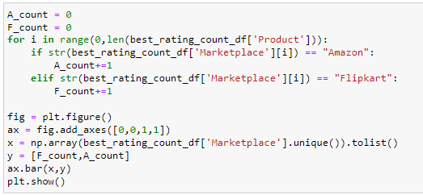
Implementation
Best Rating Count Analyzing:-

Slide 29
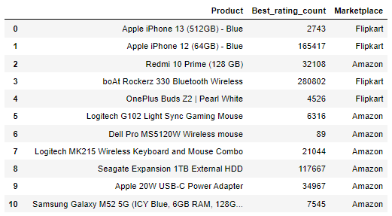
Results & Discussion
Best Rating count Analysis:-
Rating count analysis tells us the best marketplace to buy a product or the marketplace users are more likely to buy a particular product.

Slide 30
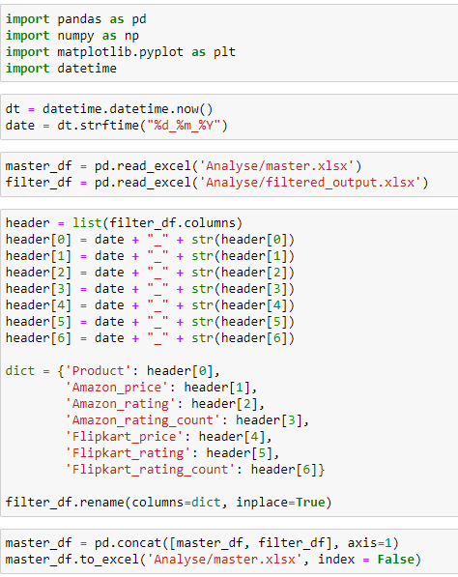
Implementation
Appending Each day filtered data to a MASTER File:-

Slide 31
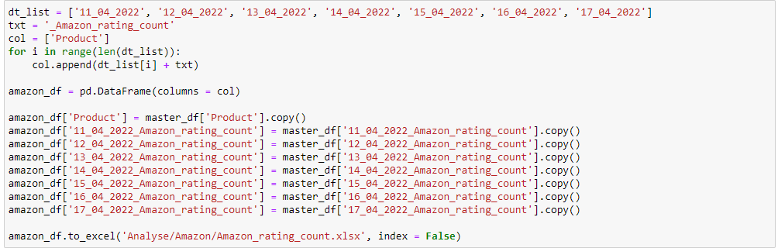
Implementation
Extracting Desired Data from Master File:-
Example – Let’s Extract Amazon Rating Count data from Master File
Here, we have extracted a week data from 11 April 2022 to 17 April 2022

Slide 32
Results & Discussion
Amazon Rating count Analysis:-
Rating count tells us the average number of sales of a product
that could have taken place by a particular marketplace at a
particular given time.

Slide 33
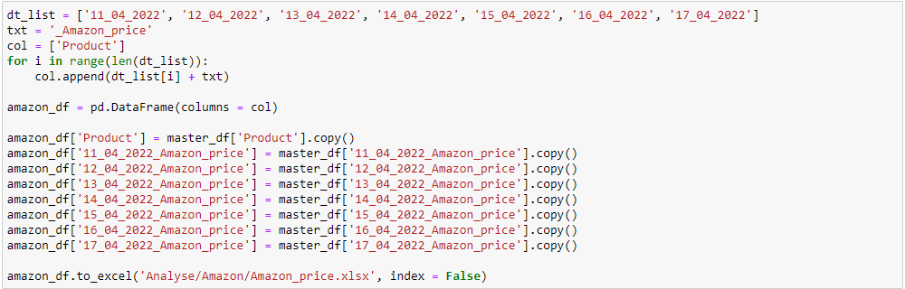
Implementation
Extracting Desired Data from Master File:-
Example – Let’s Extract Amazon Price data from Master File
Here, we have extracted a week data from 11 April 2022 to 17 April 2022

Slide 34
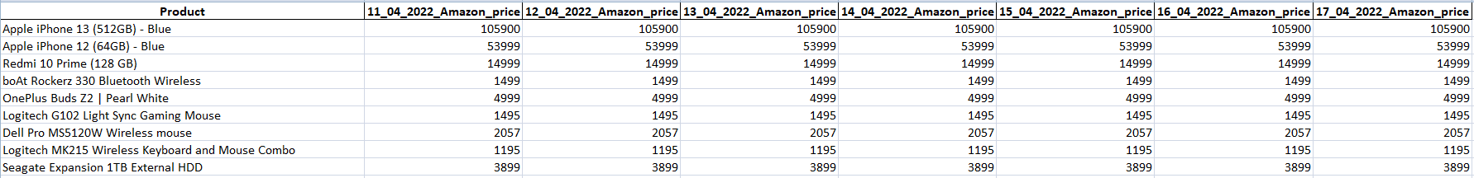
Results & Discussion
Amazon Price Analysis:-
Price Analysis tells us how the price changes over time. We can
also conclude at what particular time the product was available
at the lowest price.

Slide 35
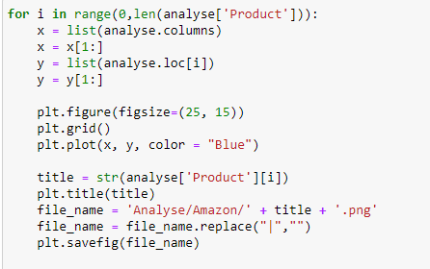
Implementation
Convert the Extracted data into Visual Form:-
We have converter the extracted data into simple line graph for detailed analysis.

Slide 36
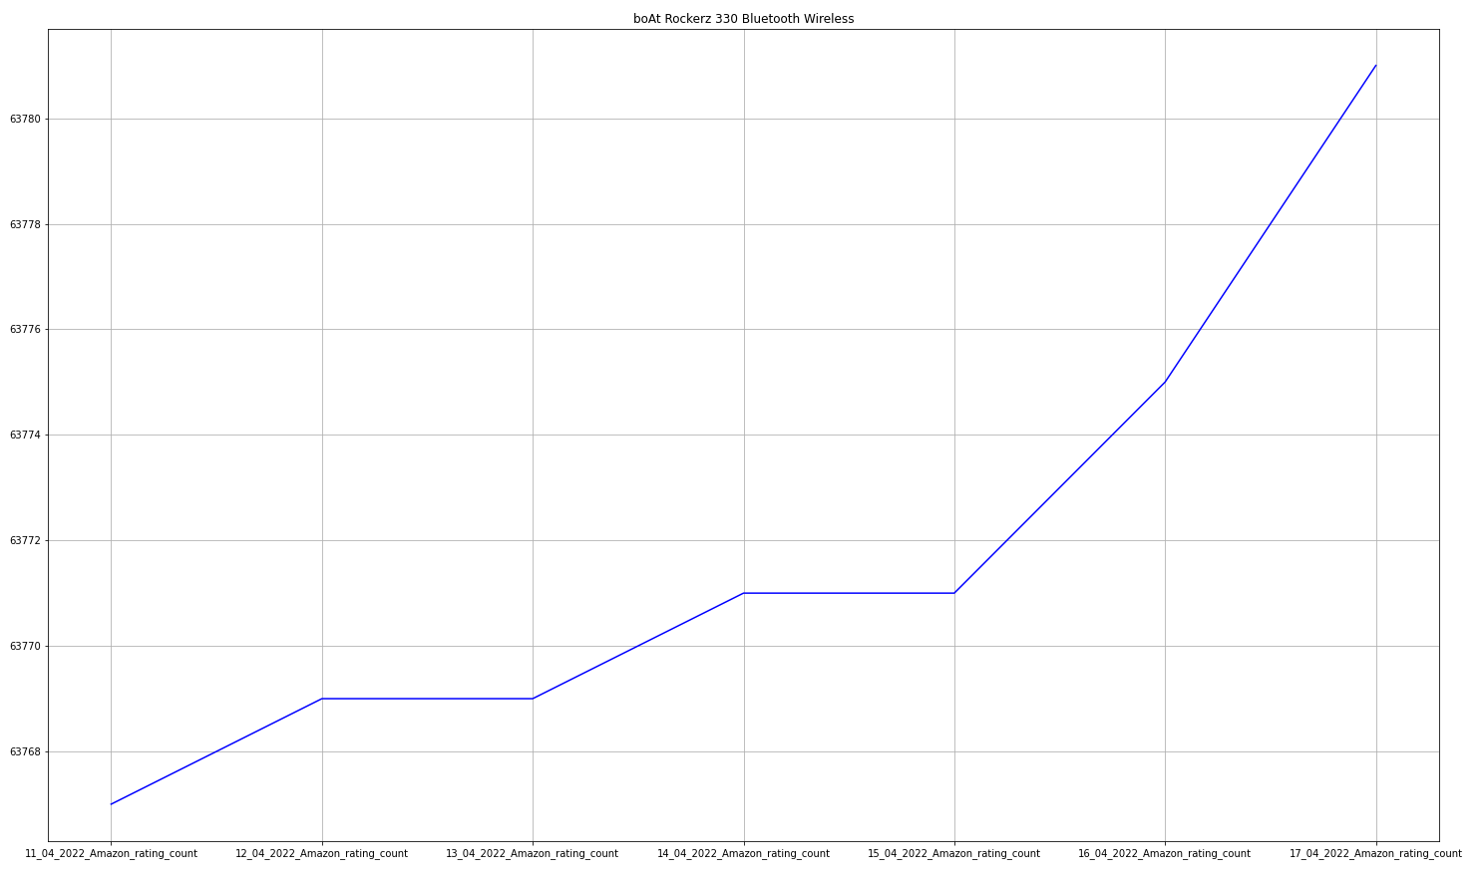
Results & Discussion
Product - boAt Rockerz 330 Bluetooth Wireless
Factor – Rating Count
MarketPlace – Amazon
Below graph shows how rating count of the product increases over time, this also Shows how the demand of
the product increases over time.

Slide 37
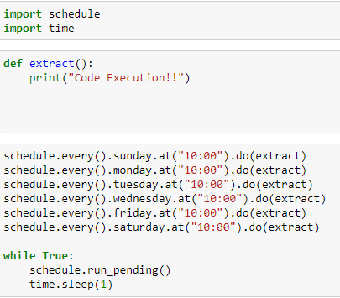
Implementation
Scheduler:-
We can schedule the whole code with the help of a scheduler. It helps in executing the
particular code at a particular time on its own.

Slide 38
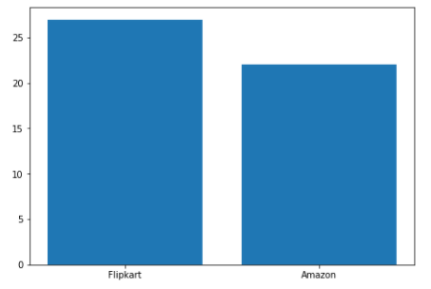
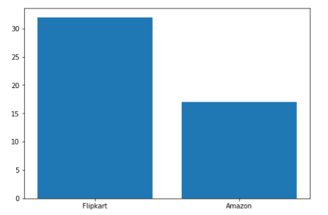
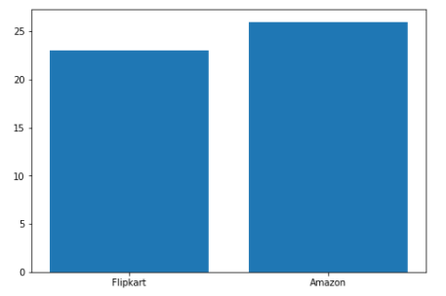
Screenshots
Best Price
Best Rating
Best Rating Count

Slide 39
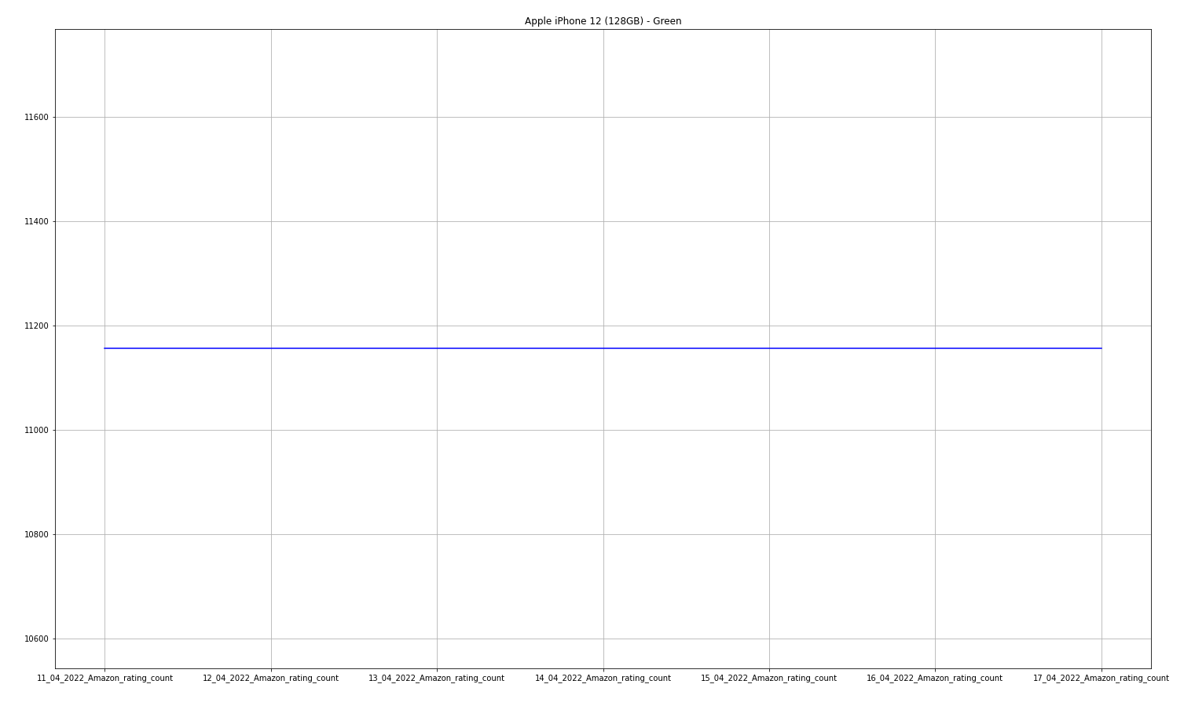
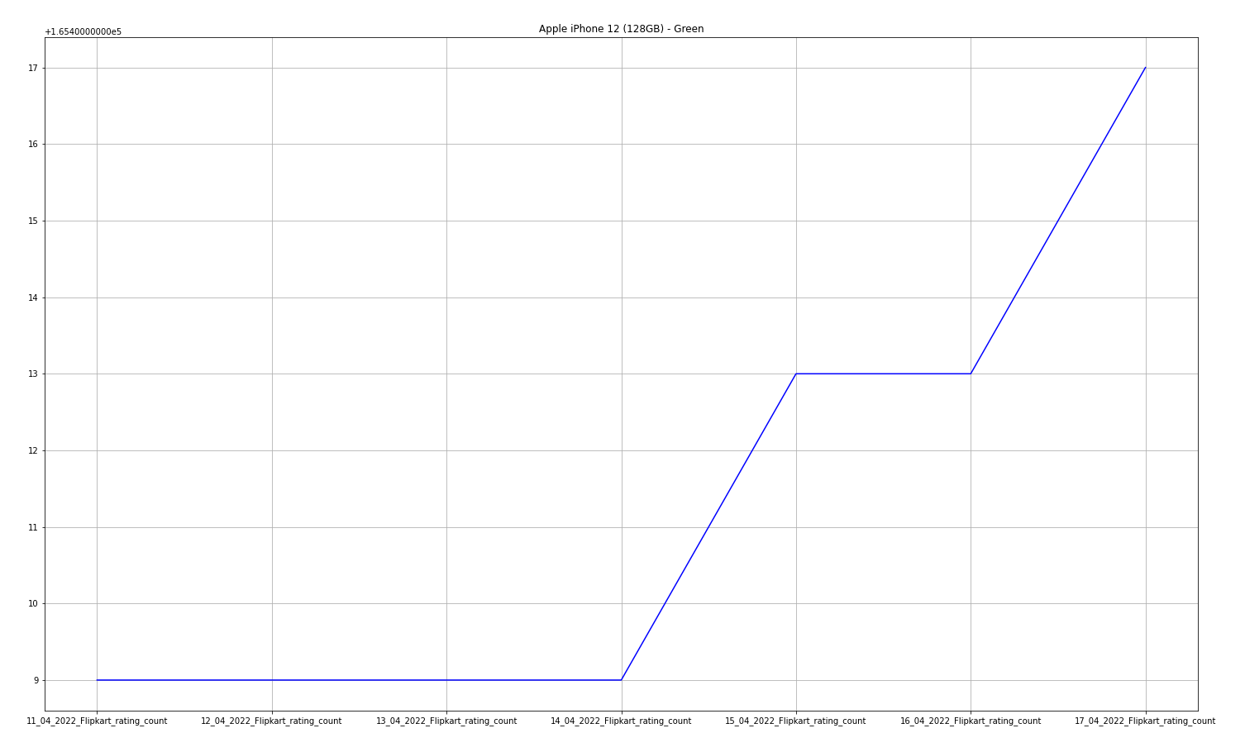
Screenshots
Comparison of Rating Count Data available on different marketPlace
Apple iPhone 12 (128GB) – Green (AMAZON RATING COUNT)
Apple iPhone 12 (128GB) – Green (FLIPKART RATING COUNT)

Slide 40
References
Renita Crystal Pereira and Vanitha T, “Web Scraping of Social Networks,” International Journal of Innovative Research in Computer and Communication Engineering, pp. 237-240, Vol. 3, 2015.
Federico Polidoro, Riccardo Giannini, Rosanna Lo Conte, Stefano Mosca and Francesca Rossetti, “Web scraping techniques to collect data on consumer electronics and airfares for Italian HICP compilation,” Statistical Journal of the IAOS, pp. 165-176, 2015.
Kaushal Parikh, Dilip Singh, Dinesh Yadav and Mansingh Rathod, “Detection of web scraping using machine learning,” Open access international journal of Science and Engineering, pp.114-118, Vol. 3, 2018.
Anand V. Saurkar, Kedar G. Pathare and Shweta A. Gode, “An Overview On Web Scraping Techniques And Tools,” International Journal on Future Revolution in Computer Science & Communication Engineering, pp. 363-367, Vol. 4, 2018.
Sameer Padghan, Satish Chigle and Rahul Handoo, “Web Scraping-Data Extraction Using Java Application and Visual Basics Macros,” Journal of Advances and Scholarly Researches in Allied Education, pp. 691-695, Vol.15, 2018.
Jan Kinne and Janna Axenbeck, “Web Mining of Firm Websites: A Framework for Web Scraping and a Pilot Study for Germany,” 2019.
Erin J. Farley and Lisa Pierotte, “An Emerging Data Collection Method for Criminal Justice Researchers,” Justice Research and statistics association, pp. 1-9, 2020.

Slide 41
Thanks

